Slide 1
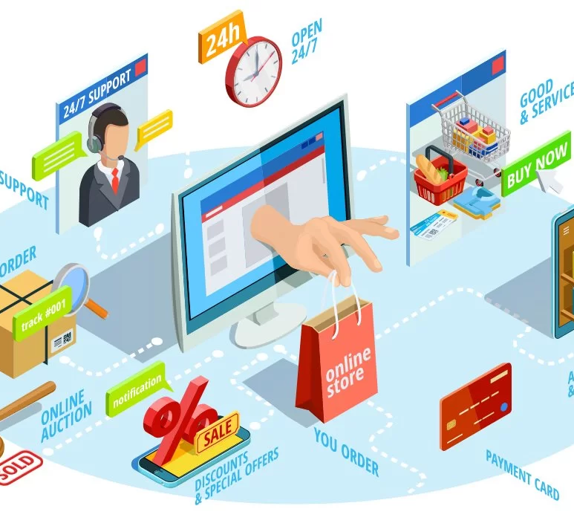
Managing Online Stores
GROUP-9
K.Dindi basanth-0040

Slide 2
ROLES & RESPONSIBLITIES
Name, Logo and Domain (Shweta & Shahank)
USP and Brand Promise (Shweta Sharma,dindi basanth)
Product Category and why? (Shashank Vishwkarma,dindi basanth)
Product Types (Shashank & Shweta)
Target Market (Shweta , Abhilasha & Shashank)
Competitor Analysis (Soumya Sahu & Ritam Bag)
Costing (Abhilasha & Shashank)
Detailed Conversion Plan (Suvendu & Ritam)
Private Labels (Suvendu & Ritam)

Slide 3
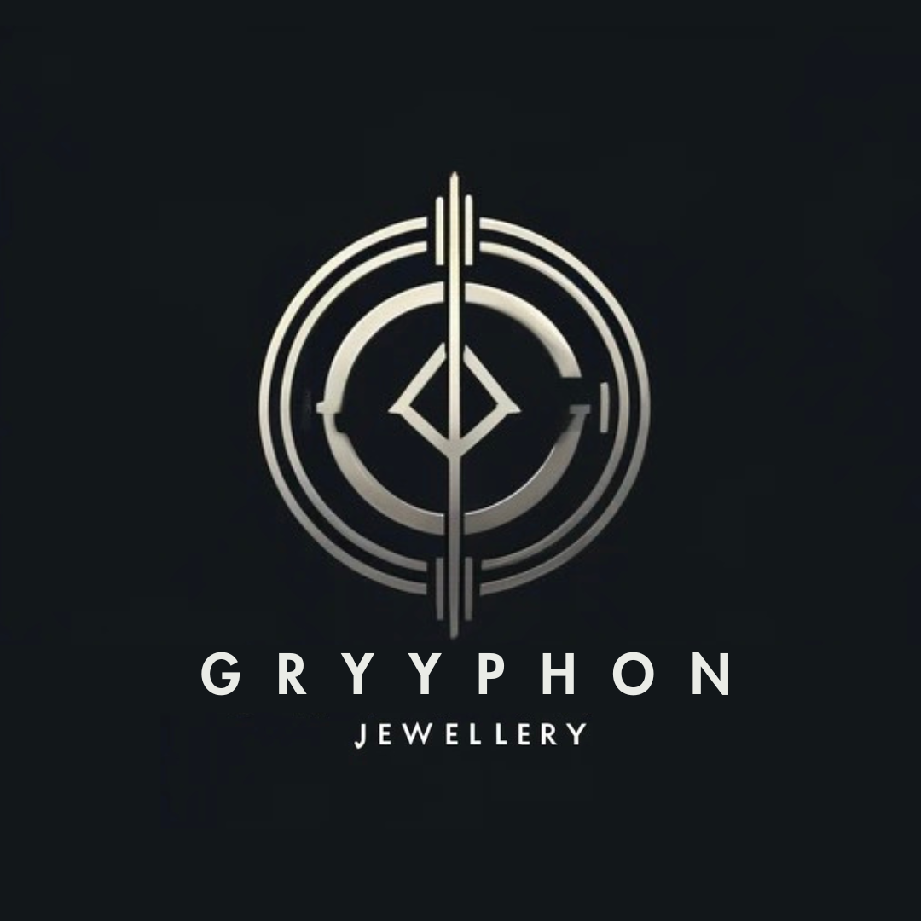
BRAND NAME & LOGO

Slide 4
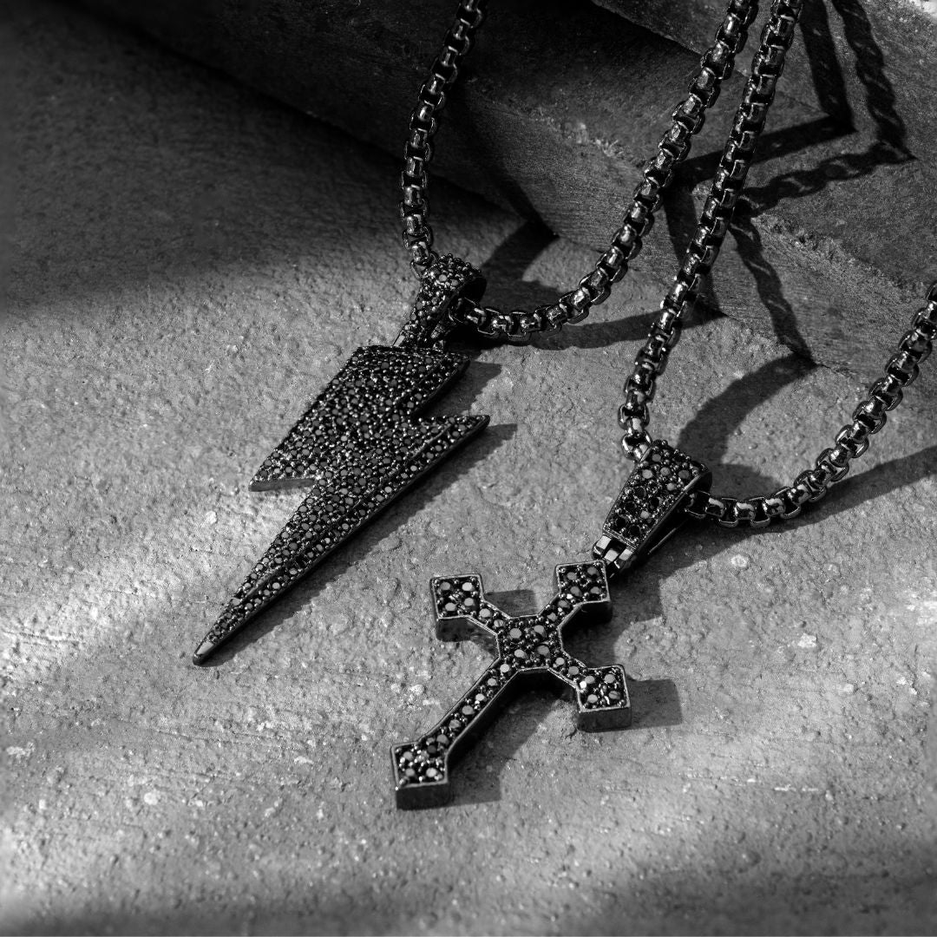
ABOUT THE BRAND
Forged for Men: Crafted for Confidence Curated collections.
Bold styles. Timeless pieces. We brings distinctive men's jewellery made with quality and designed to last. Explore & elevate your look

Slide 5

DOMAIN NAME
https://gryyphon.com/

Slide 6
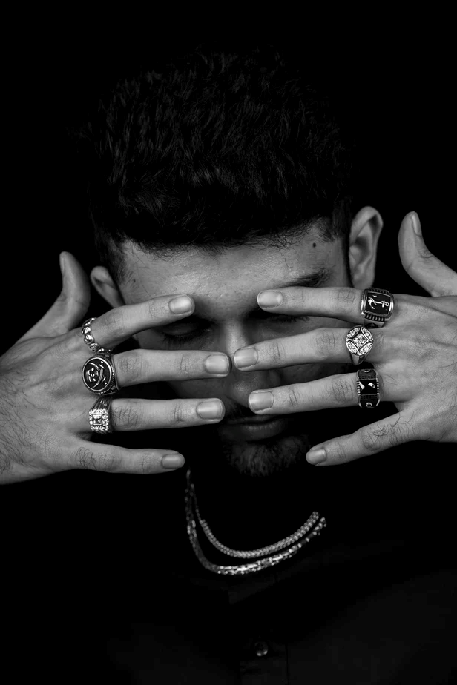
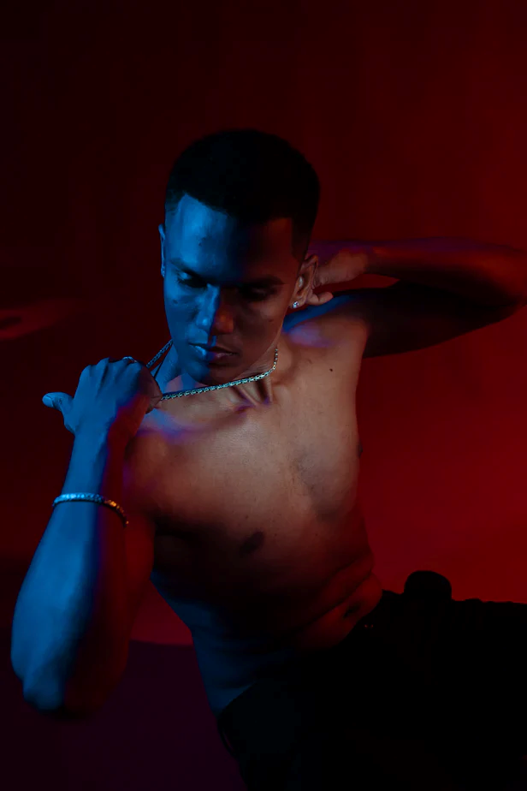
CATEGORY OF PRODUCTS
MEN’S JWELLERY –
EARRINGS
RINGS
CHAINS
PENDANTS

Slide 7
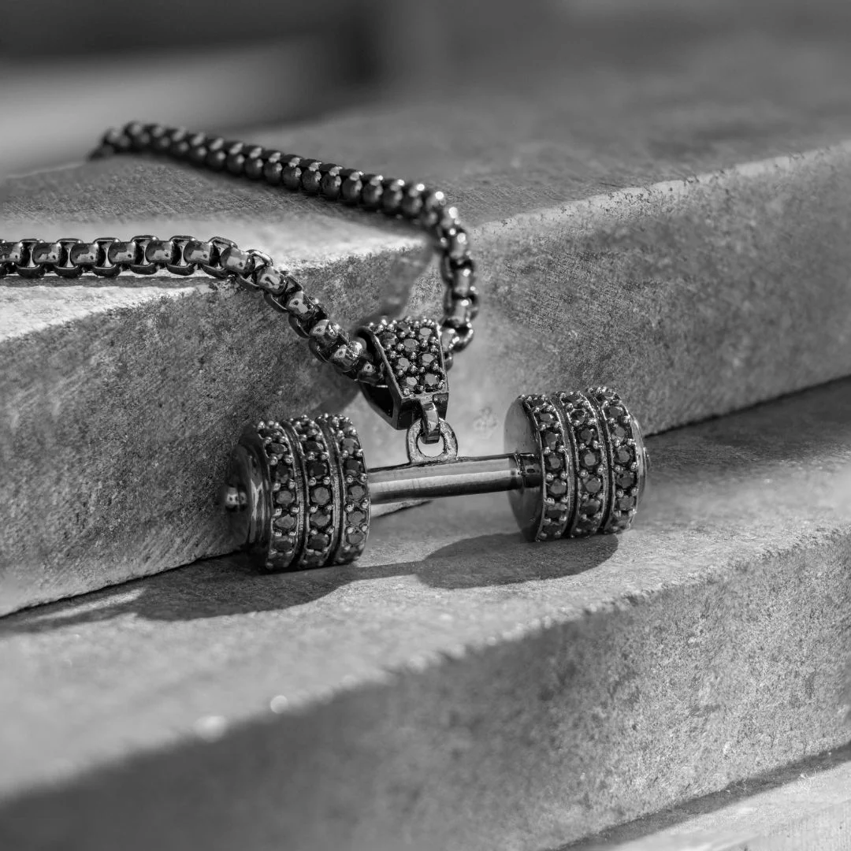
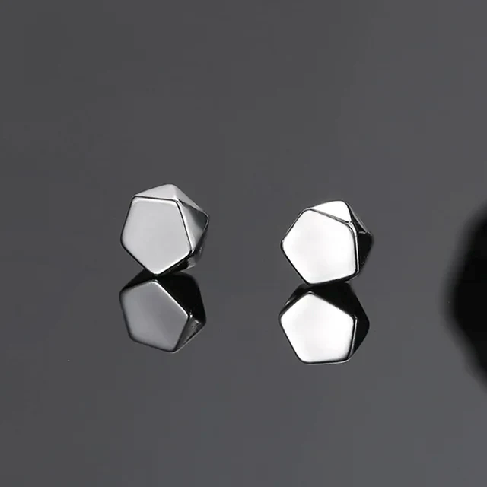
OUR PRODUCTS

Slide 8
USP AND BRAND PROMISE
USP – "Elevate your style with ethically sourced, artisanal men's jewellery."
Brand Promise – "Discover timeless elegance and conscientious craftsmanship in every piece of our men's jewellery collection. We promise to offer you not just accessories, but statements of style and integrity.”

Slide 9
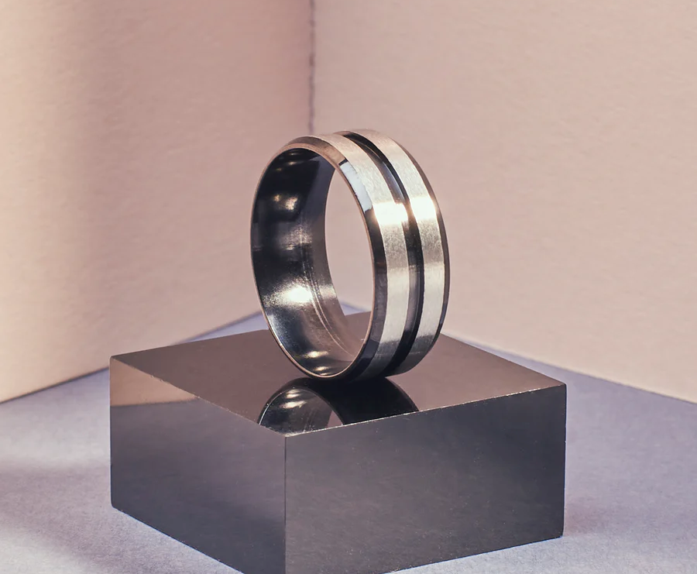
MEN'S JEWELLERY! WHY?
Used across age groups
Men of all ages appreciate stylish and high-quality jewelry.
Less number of returns
Our jewelry ensures satisfaction with fewer returns due to superior quality and design.
High demand leading to growth potential
The men's jewelry market is expanding rapidly, showing significant growth potential.
Trendy, irrespective of seasons
Our designs are versatile and fashionable all year round.
Everyday product
Jewelry that complements daily wear, from casual to formal occasions.
High search but low competition
A burgeoning market with high interest yet lower competition compared to other accessorie

Slide 10
WHY MEN’S JEWELLERY?
Market Size
t
TAM
Total Addresable Market
Market size of artificial jewellery
$904 million
Adoption rate
8%
SSAMSAA
SAM
Servicable Available Market
Market size of our products
Adoption rate
8%
Servicable Obtainable Market
Market size of age segment
Adoption rate
8%
SOM

Slide 11
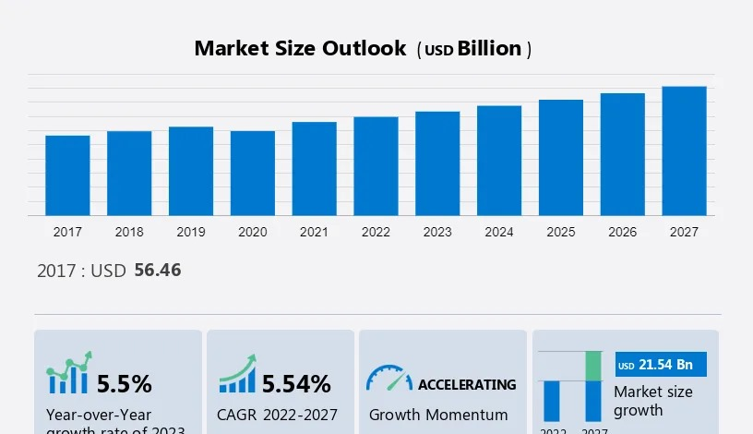

Slide 12
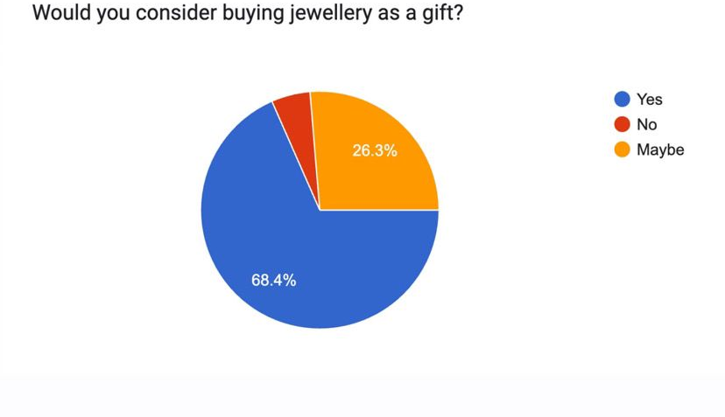

Slide 13
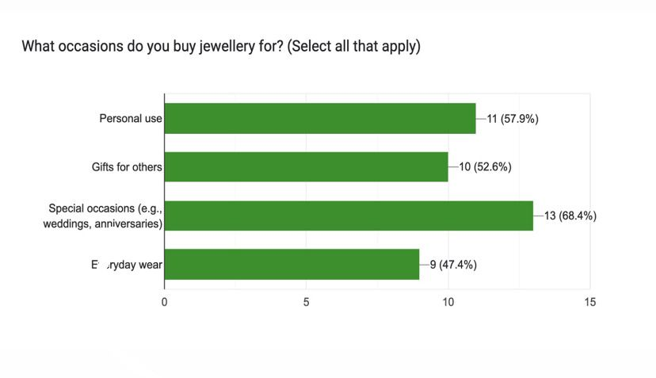

Slide 14
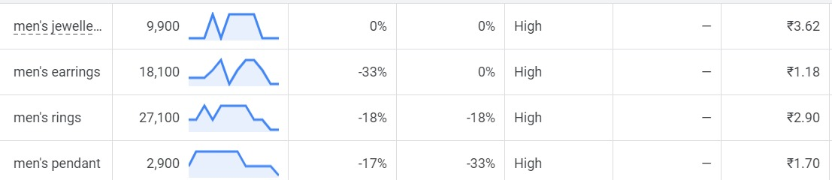
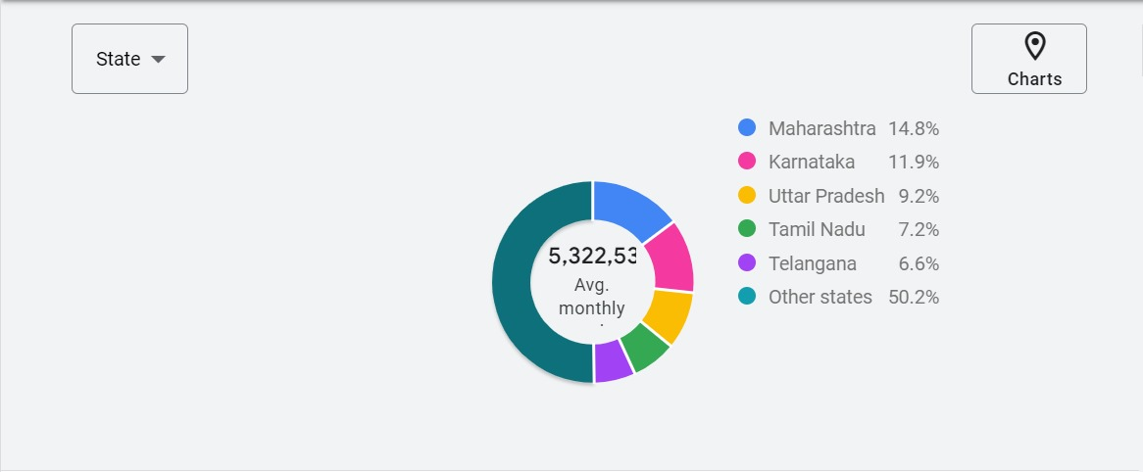
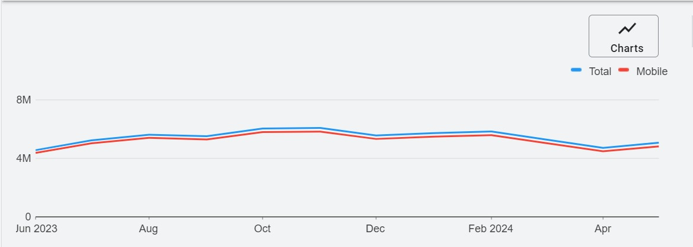
DEMAND ASSESMENT USING KEYWORDS

Slide 15
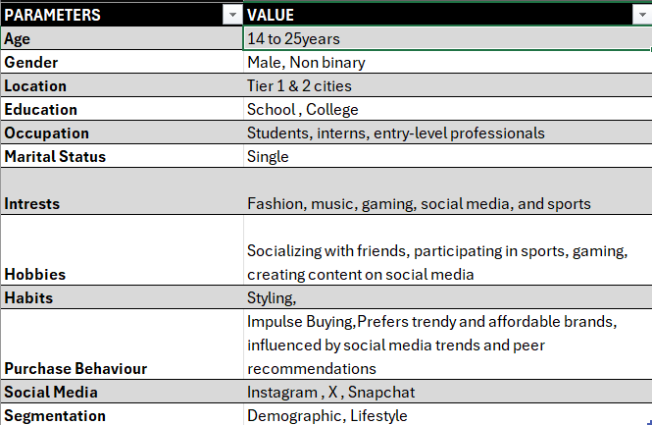
PRIMARY TARGET AUDEINCE

Slide 16
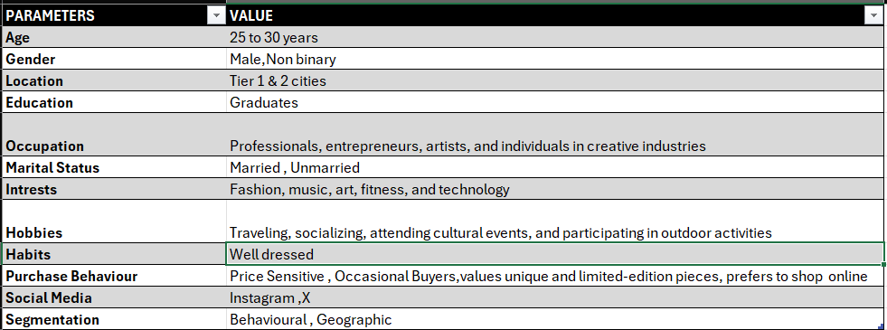
SECONDARY TARGET AUDEINCE

Slide 17
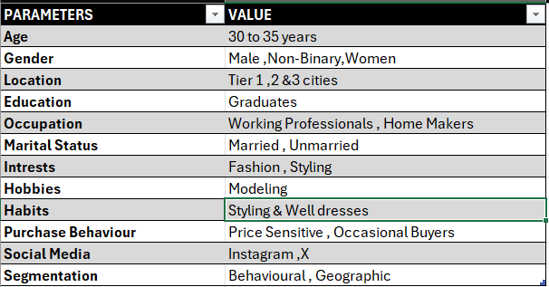
POTENTIAL TARGET AUDEINCE

Slide 18
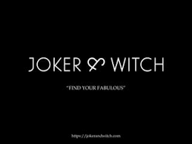
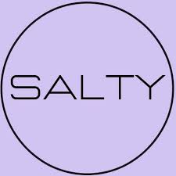
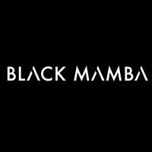
OUR COMPETITORS

Slide 19
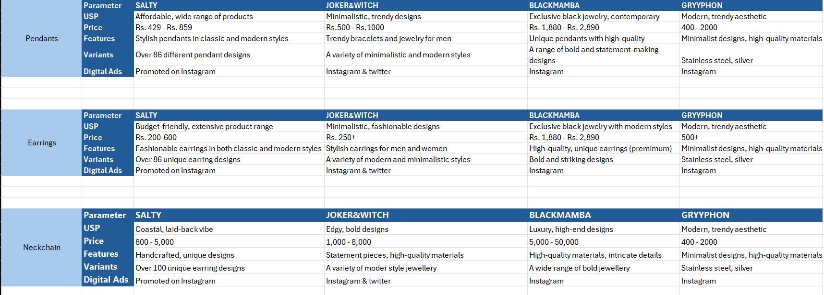
COMPETITORS ANALYSIS

Slide 20
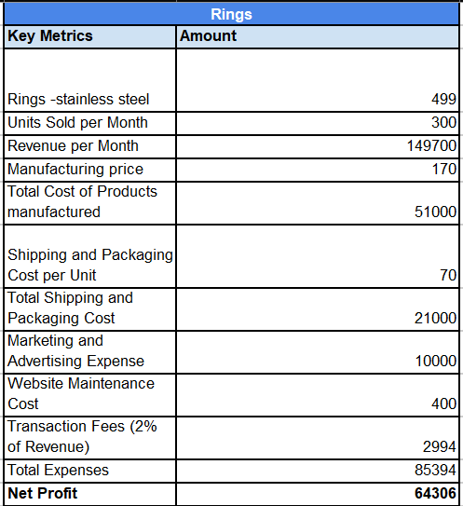
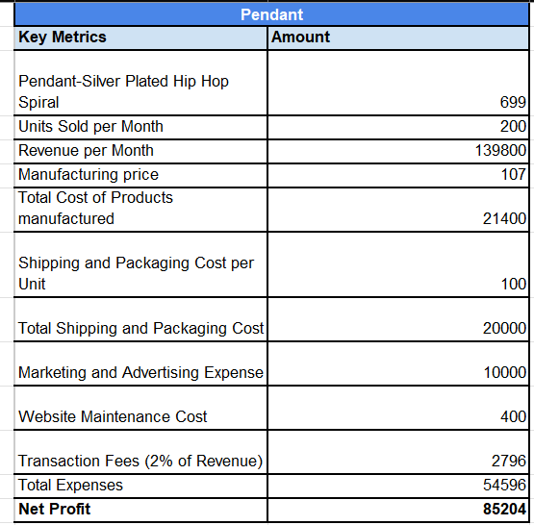
COSTING

Slide 21
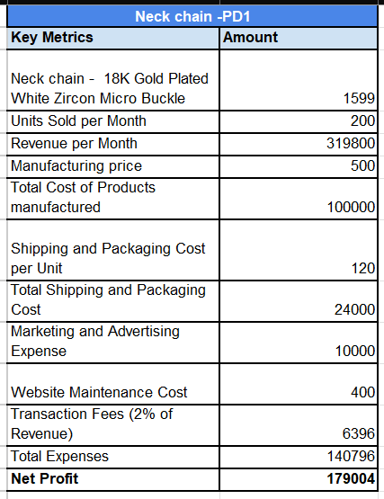
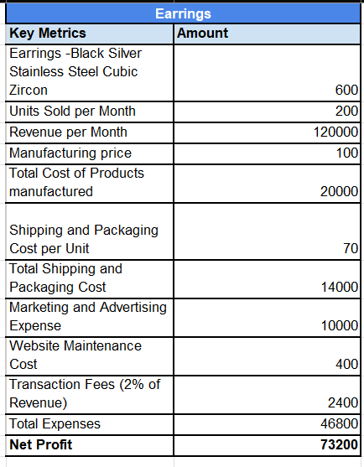

Slide 22
KEYWORDS
METRICS | KEYWORDS | TRAFFIC/ USERS | CTR | CONVERSIONS
PRODUCT -1 EARRINGS | Men’s stud earrings , Men’s earrings, Earing rings,earings, gold hoop earings | 20711 | 0.51% | 0.00%
PRODUCT-2 RINGS | Men rings,rings style,earring rings | 3470 | 0.40%` | 0.00%
PRODUCT -3 NECK CHAIN | Mens jewllery,men neckchains, neckchain for guys | 1445 | 1.45% | 0.00
PRODUCT-4 PENDANT | Mens pendent, silver pendent,pendent for guys | NA | NA | -

Slide 23
PRIVATE LABELS
Design and Quality Requirements
Packaging Requirements
Delivery and Purchase

Slide 24
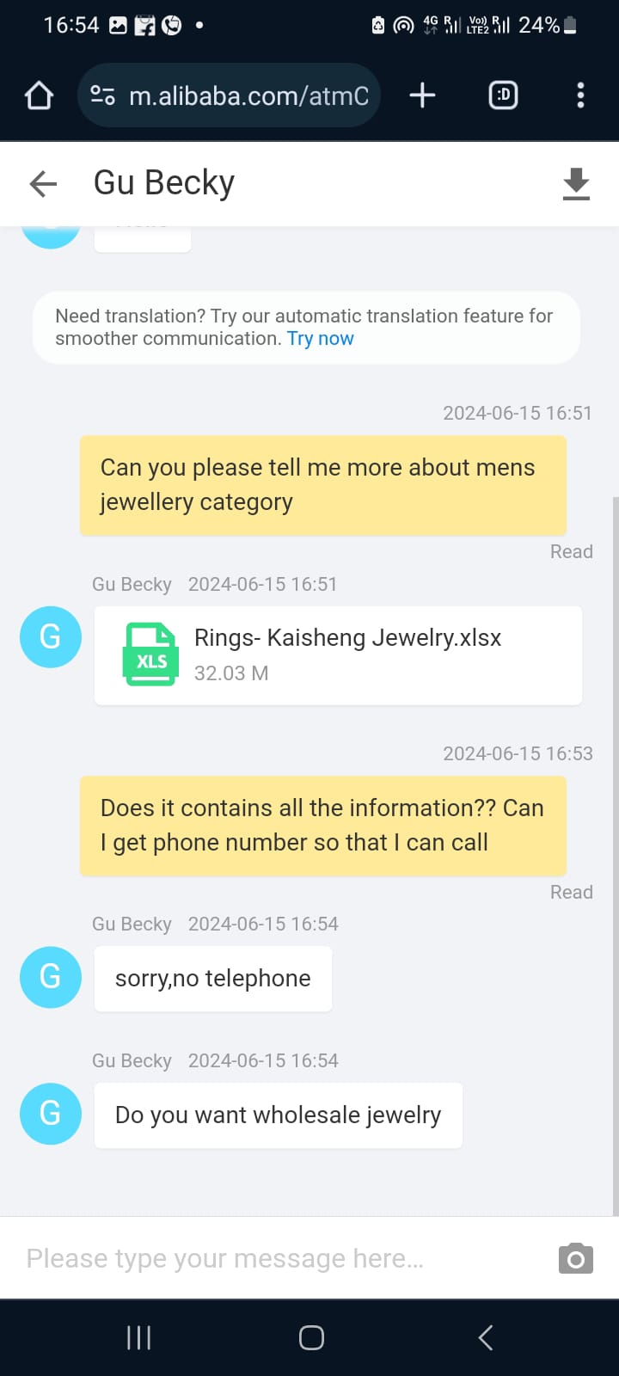
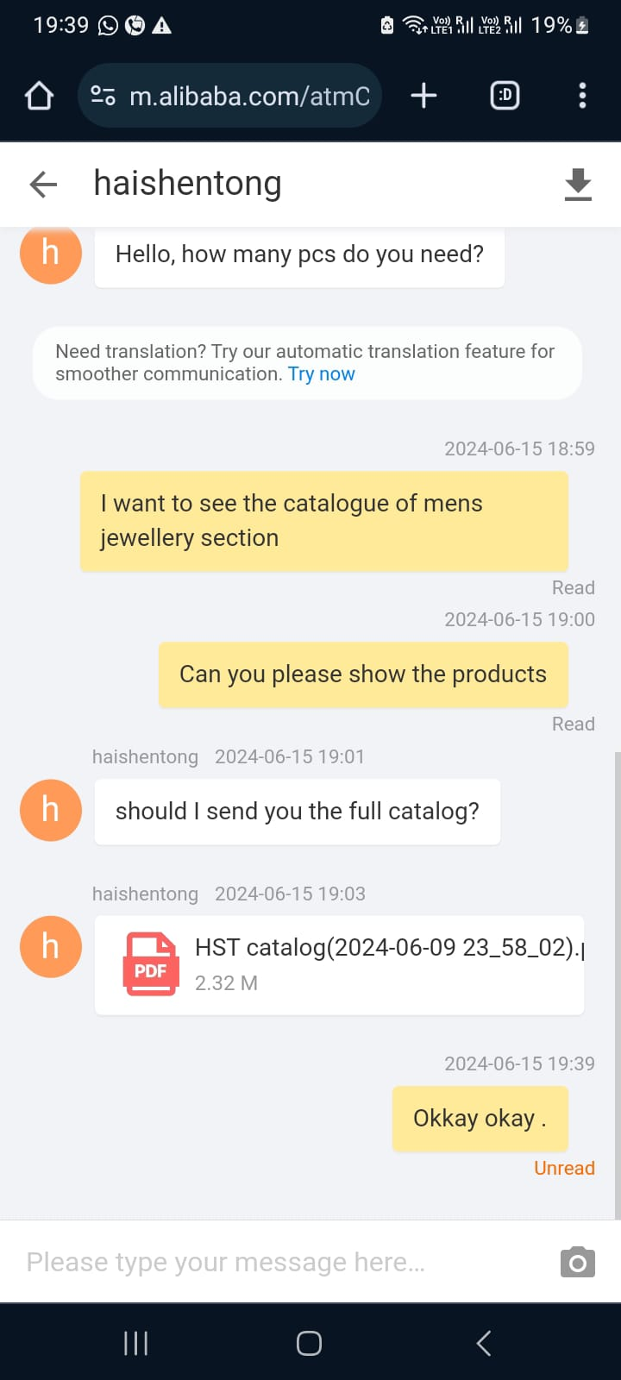
PRIVATE LABELS

Slide 25
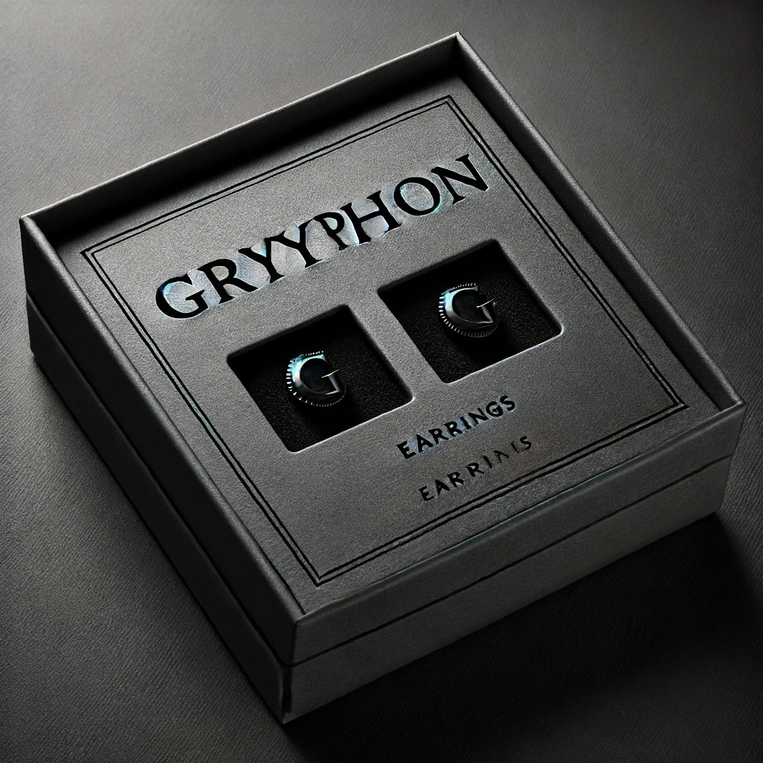
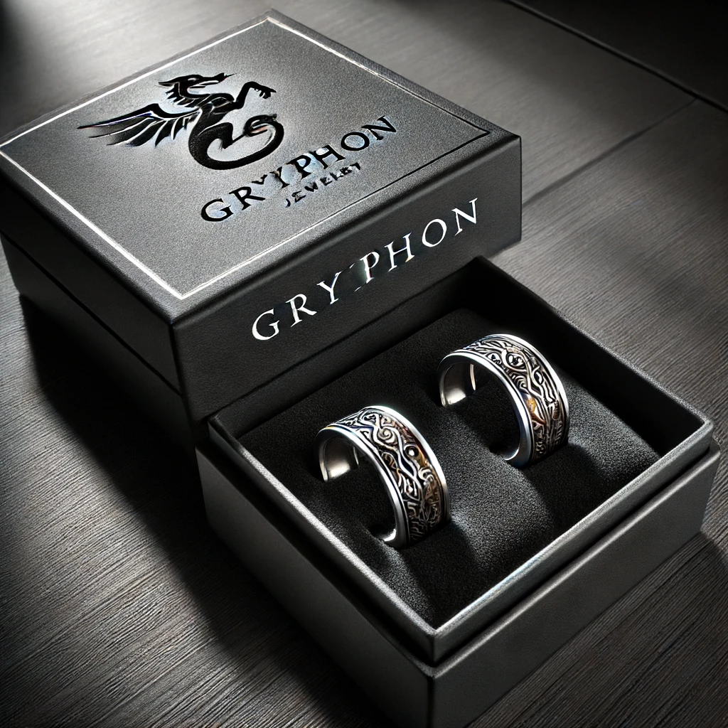
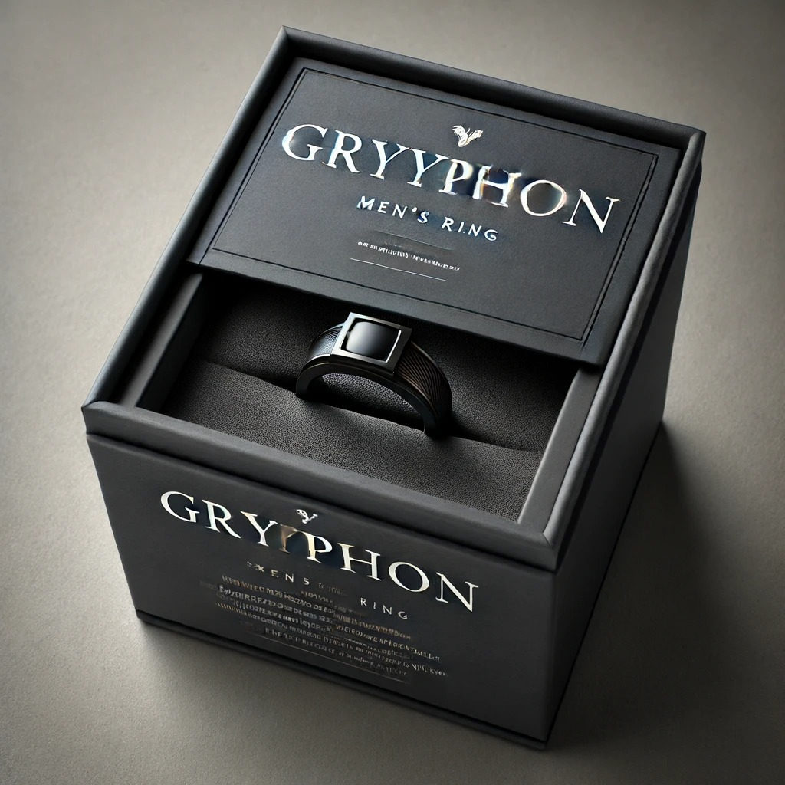
PACKAGING DESIGNS

Slide 26
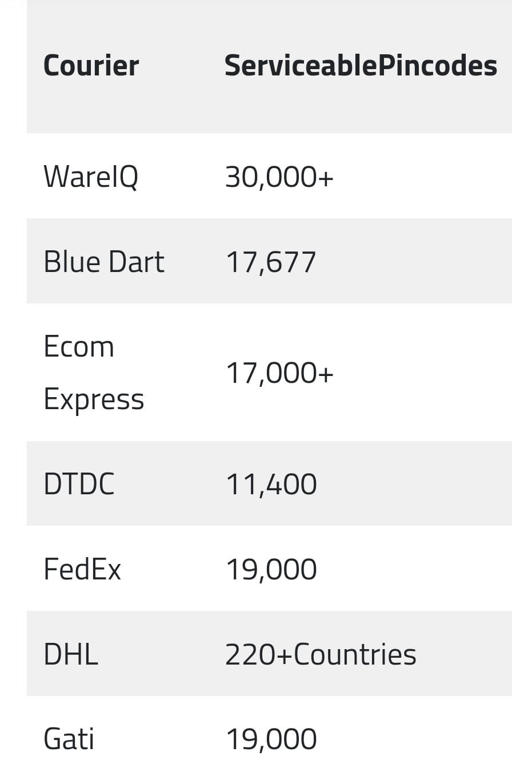
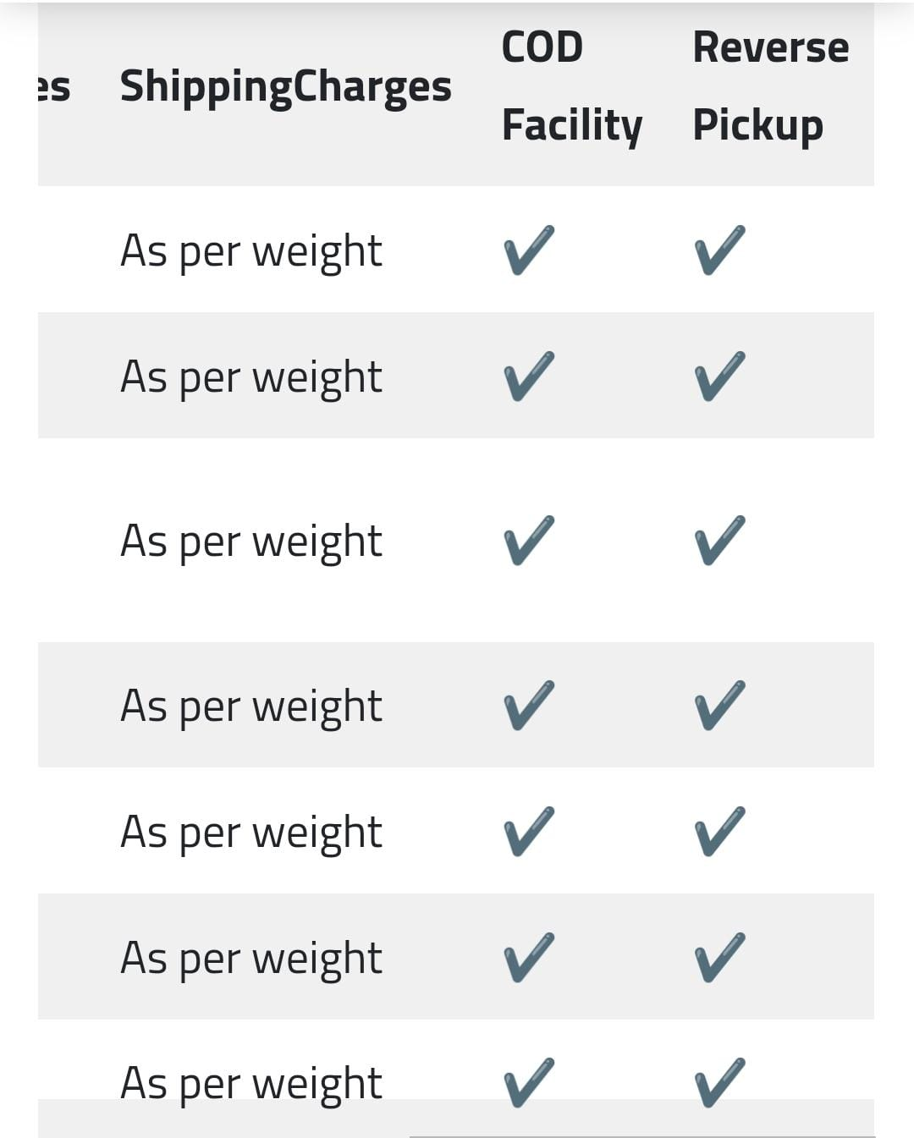

Slide 27
THANK YOU

